Slide 1
Aqara Smart Curtain Controller Introduction

Slide 2
Content
Product introduction
Product installation
Configuration on App
FAQ

Slide 3
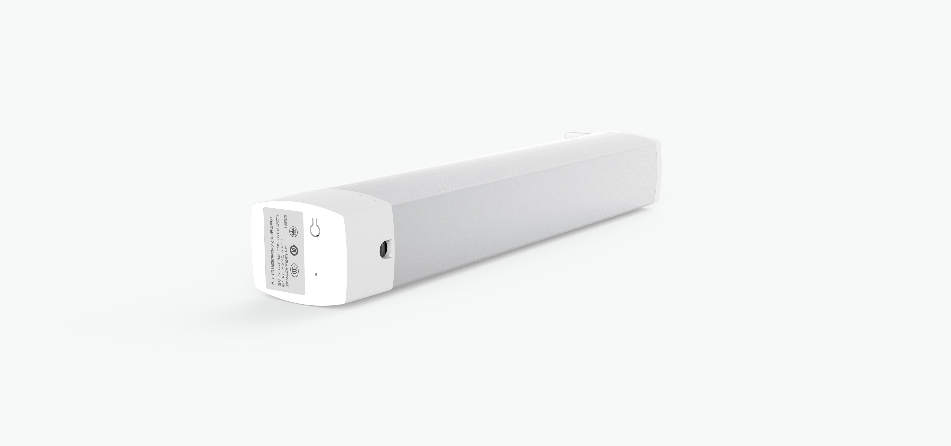


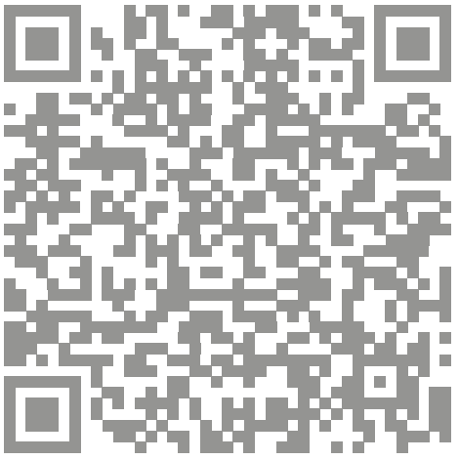
Product Profile
Aqara Curtain Controller is a ZigBee wireless communication protocol based, using ultra-quiet DC motor, with resistance to stop, stops when pull by hand and other characteristics, with ZigBee hub function with the device (referred to as "hub"), can achieve remote control, timer switch and devices, smart linkage and other functions.
Please scan the QR code to watch the product video.
One-click Control
Reset Button
Remote Control
Schedules
Custom Percentage
Indicator
*This product is for indoor use only. Please bind the product to the Hub before use.
*Aqara Hub is required to enable Aqara Smart Curtain Controller to work with Homekit.

Slide 4
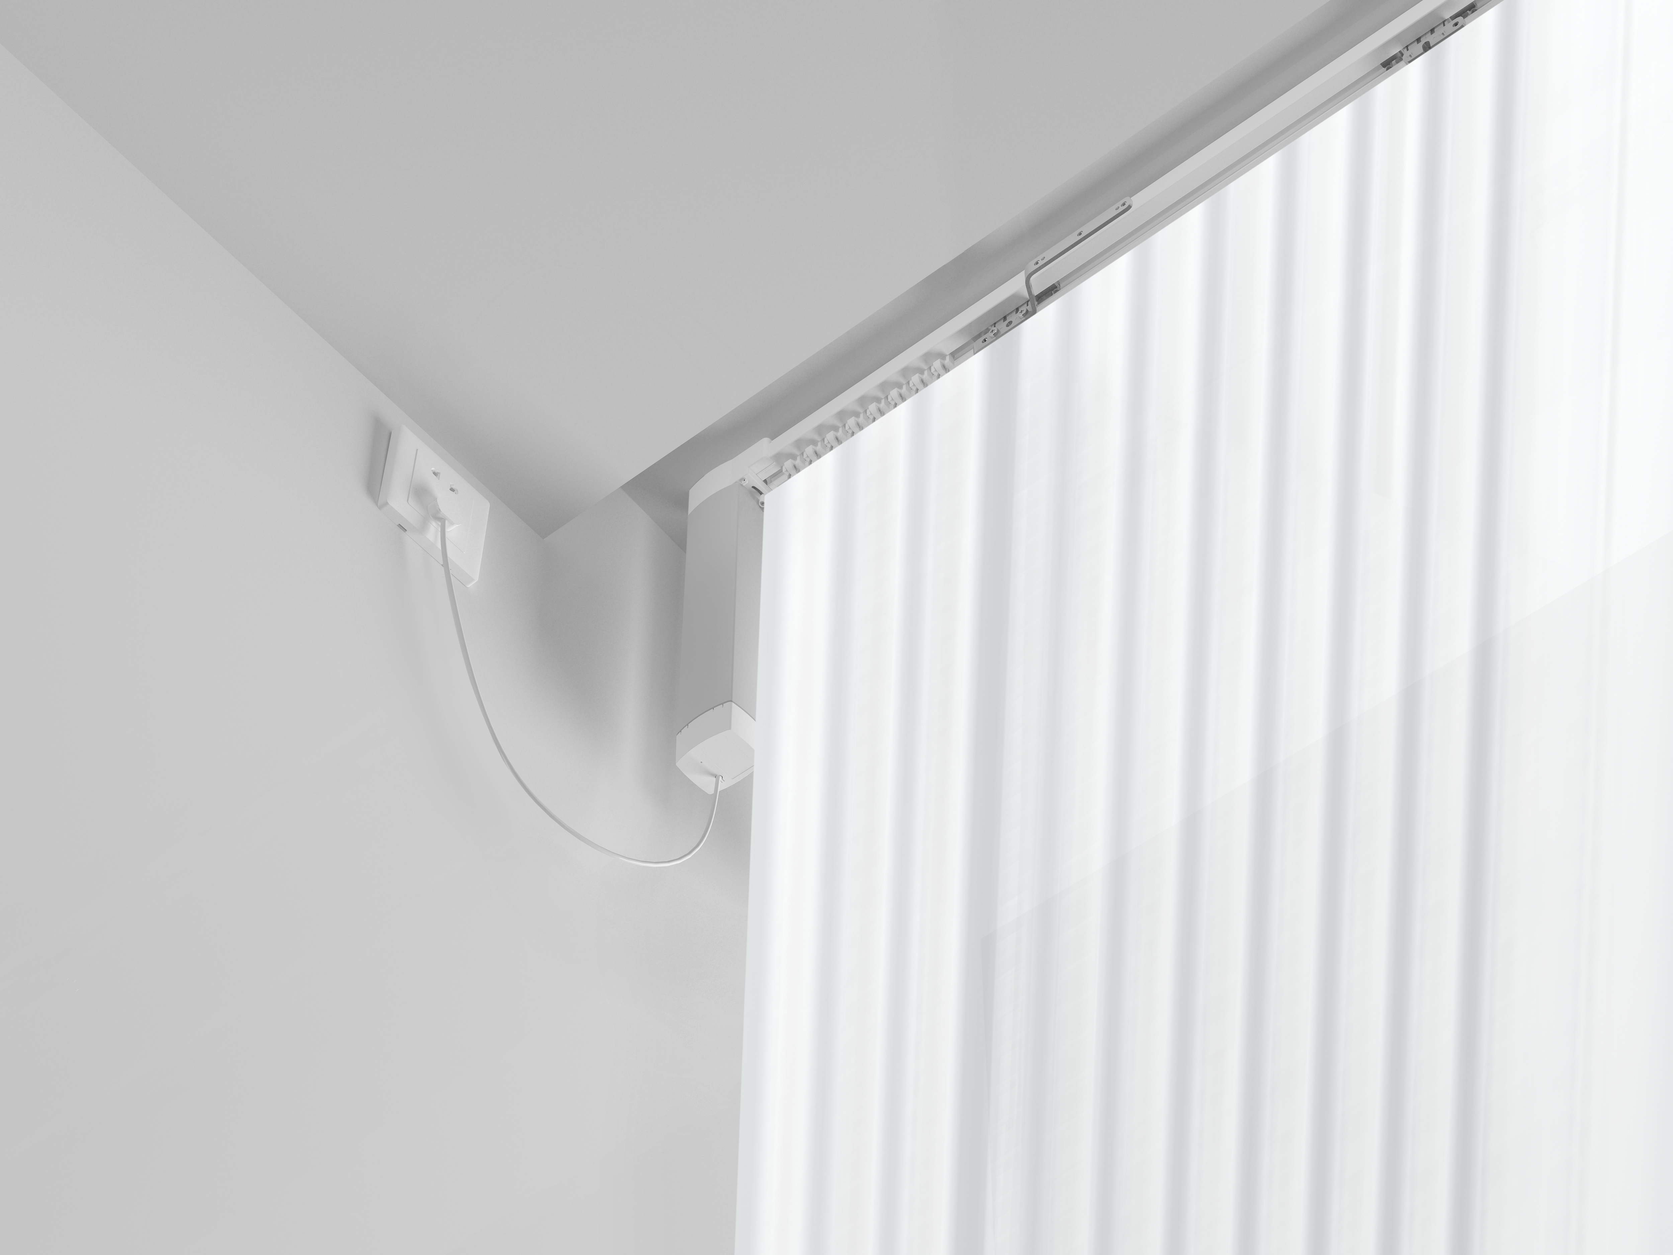
Smart Curtain Controller Usages
Aqara smart curtain controller can be used at home/office/hotel and so on.
Usage 1:
Your curtain will close automatically in case you go out.
Usage 2:
Use your Aqara Hub M1S as an illumination sensor to adjust your curtain dynamically.
Usage 3:
Control the curtain using the configurable gestures of the Aqara Cube or any other compatible wireless controller.

Slide 5
Product Selling Points
Customize Opening/Closing Position
All-Round Compatibility
Schedules
You can save your favorite opening percentages via smart scenes and switch between them easily.
Supports the most popular voice assistants and ecosystems.
Your shades will open and close at a specified time of the day, for example, right before your alarm clock.
Smart Home Automation
Multiple Control
Various Curtain Mode
Can be triggered by sensors such as Illumination, Motion, Door and Window Sensor, and more.
Can be fully controlled by a single button such as the Wireless Mini Switch. And also support control manually.
Apart from opening both, it also supports open left curtain and open right curtain.

Slide 6
Product Specifications
Specifications | Zigbee Version
Model | ZNCLDJ11LM
Supply Voltage | 100-240V~50/60Hz
Cable Length | 1 meter（Plug is excluded）
Noise | Around 30dB
Torque | 1.2N·m
Dimensions: | 70 x 50 x 346 mm
Protection Standard | IP40
Weight | 1.5 kg
Opening Speed | 14cm/s
Max Load | 50KG
Communication Protocol | Zigbee
Operating Temperature | -20°С +55°С
Operating Humidity | 10% - 90%RH，non-condensing
Power | 13W
Package Contents | Motor, User Manual.

Slide 7
Button Functions
Reset button
Long press for 5s: Reset/Add the device;
Single press: Effective range test/Device identify;
Indicator light
.
Effective range test: When single press the reset button, the Hub will make voice prompt of “Normal link confirmed” , it means the connection between the device with Hub is normal.
Device identify: When single press the reset button, the device will flash on the app at the menu of Accessories.

Slide 8
Indicator Functions
No. | LED indication | Implication
1 | Blue light flash once | Power on, the blue light flashes once
2 | Blue light always on | Connected, motor is running
3 | Blue light continues to flash quickly | Connecting
4 | Red light flashes slowly | Not connected (or reset to factory)

Slide 9
Content
Product introduction
Product installation
Configuration on App
FAQ

Slide 10

Product Installation
Please watch the installation video from the link below:
https://cdn.cnbj2.fds.api.mi-img.com/cdn/single-h5/Channel/aqaradetails/aqaracurtain.html?v=20180926

Slide 11
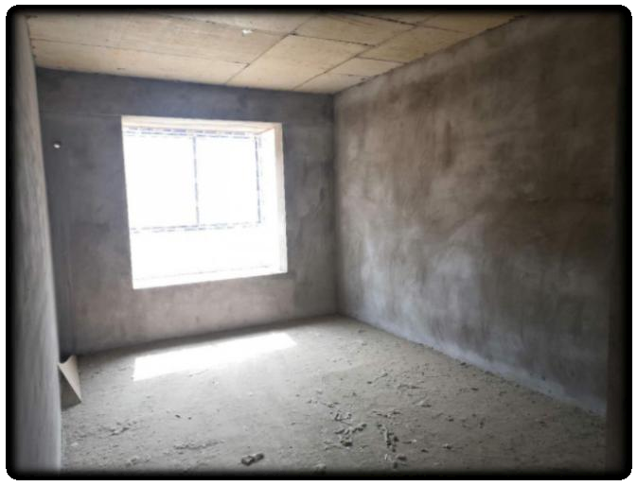
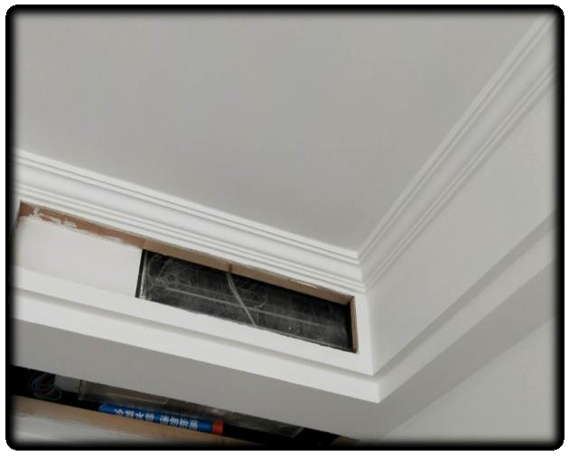
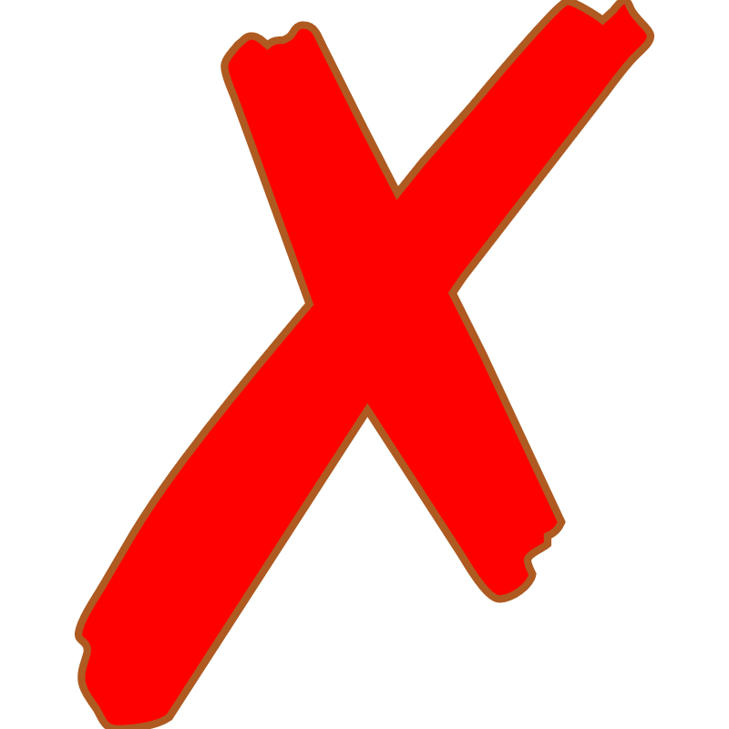
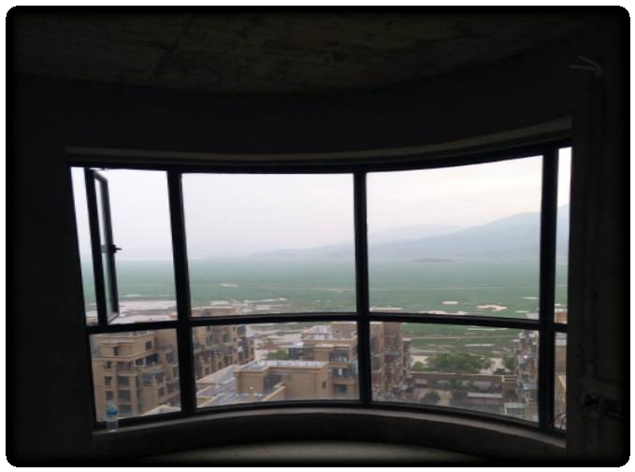
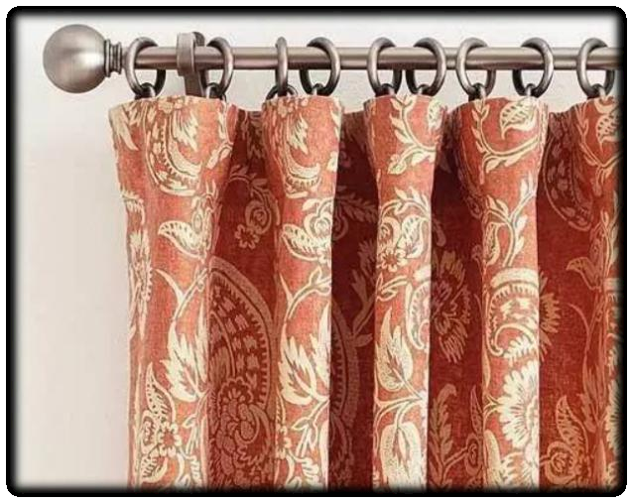
Product Installation- Measure Preparation
Installation Environment
Roughcast House
Gypsum Ceiling
Customized(Curved) Window
Roman Rod

Slide 12
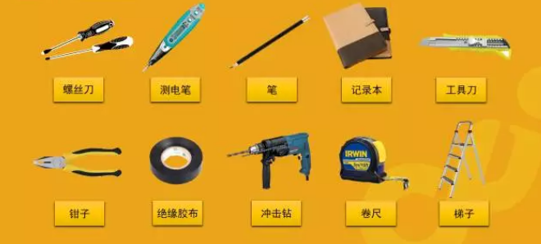
Product Installation- Measure Preparation
Measure Preparation
Screwdriver
Test Pencil
Pencil
NoteBook
Tapeline

Slide 13
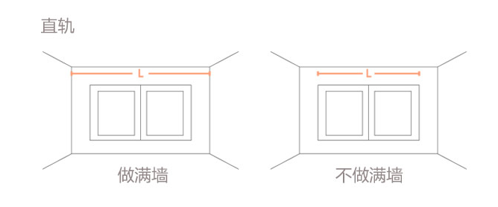
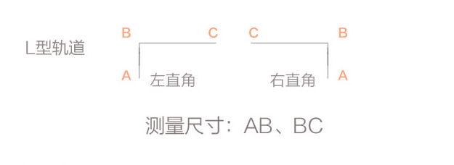

Product Installation- Measure Preparation
Measurement Method
Straight Track
L Shape Track
Left
Right
Measure: AB, BC
whole wall
non-whole wall
Please confirm with customer it is whole wall installation
or not before measurement.
L Shape Track
Note:
1. Track is a customized product that cannot be returned or replaced
2. Roma rod is not support. It need to be demolished if already install and replace it with the curtain(open and close from left and right).
3. Measurement should be performed after the customer finishes the decoration instead of before it.
4. Hollow wall and gypsum board are not solid enough to support. Please ensure the wall is firm enough to insall the curtain controller, like the walls made up of carpentry board or stone.

Slide 14
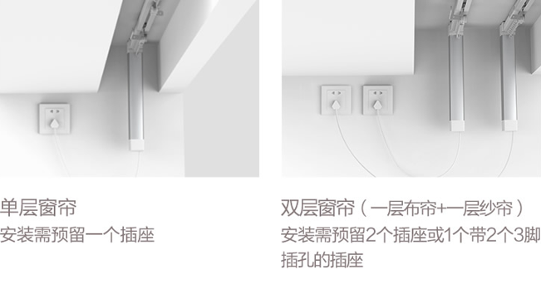
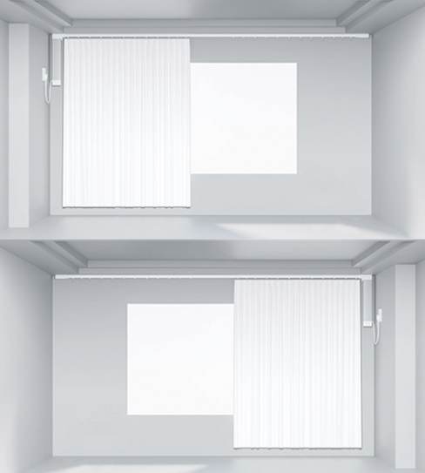
Product Installation- Measure Preparation
Power Source/Socket Preparation
Curtain controller can be installed either on the left or right, which is depended on customer's preference.
Single-layer curtain
*one power socket required
Double-layer curtain
*Two power sockets required
Note: Curtain controller comes with 1m power wire(no plug included). If there is no 10A power socket existing nearby, customer need to prepare extension wire themselves.

Slide 15
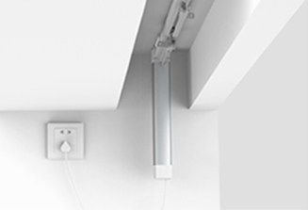
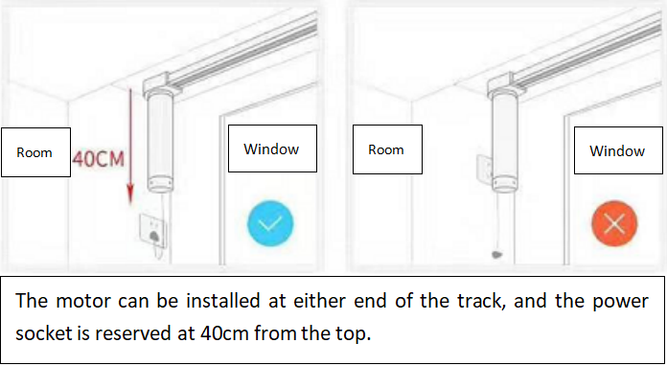
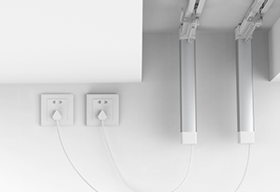
Product Installation
Power Source/Socket Preparation
•
Curtain motor comes with a 1m long power cord (plug is excluded). If there is no reserved power cord or 10A socket on one side of the shutter motor in the home, the user needs to prepare the extension cord or have the installer assist to connect the home power cord directly with the motor power cord for use.
Single Curtain Motor
1 Power socket is required to be reserved.
Dual Curtain Motor (1 Cloth +1 Sheer Curtain)
2 Power socket is required to be reserved.

Slide 16
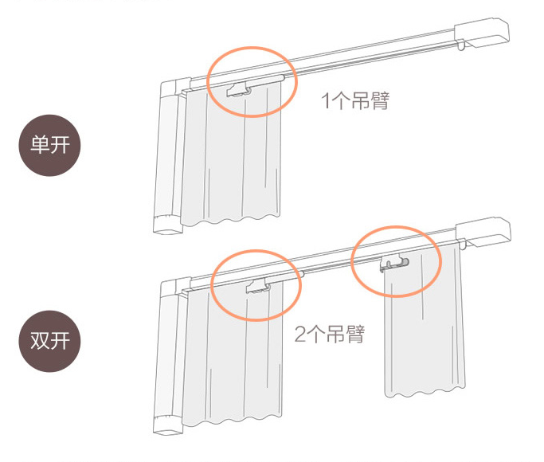
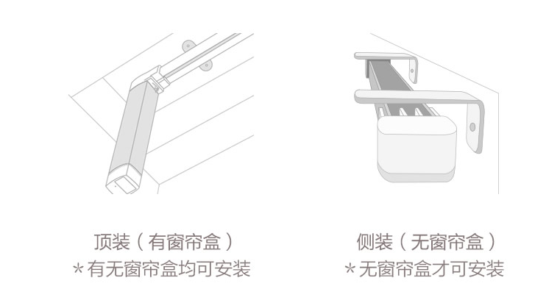
Product Installation- Measure Preparation
Installation Method
1*lazy arm
One way
Two way
2*lazy arm
Ceiling mounting
(with curtain box )
*It can be mounted on the ceiling with/without curain box
Wall Mounting
(without curtain box )
*Mounting with curtain box is not permitted

Slide 17
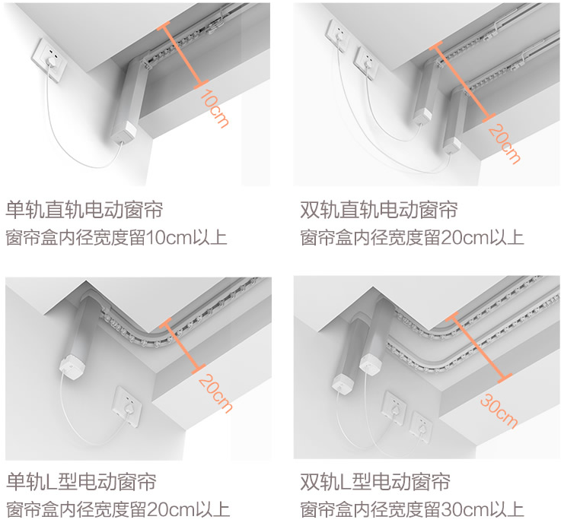
Product Installation- Measure Preparation
Measure Curtain Box
Single Straight Track
Inner diameter＞10cm
Double Straight Track
Inner diameter＞20cm
Single L Track
Inner diameter＞20cm
Double L Track
Inner diameter＞30cm

Slide 18
Product Installation
Installation Preparation
Screwdriver
Test Pencil
Pencil
Notebook
Cutter
Plier
Electrical Tape
Hammer Drill
Tapeline
Ladder
Before Installation:
1. Check if the number of the controller and track, make sure they match the customer's requirement.
2. Make sure the controller and track are not damaged due to transportation.
3. Power on the controller tp confirm if it works properly.
4. Measure the track's dimesion and check whether it matches the original data or not.

Slide 19
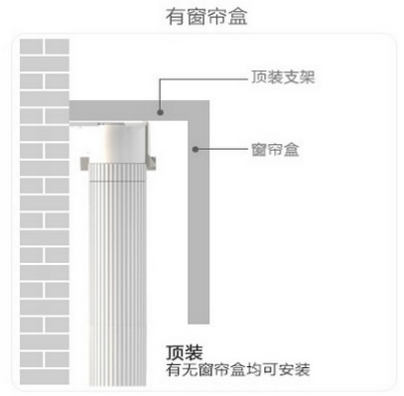
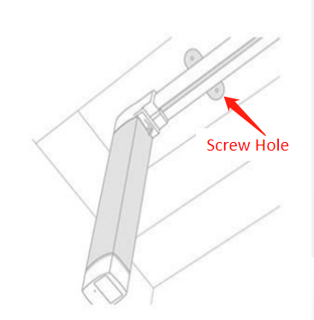



Product Installation
Ceiling Mounting
Ceiling material supports installation-- it needs to be determined by the installer or user whether it can bear the load.
With Curtain Box
Note: Ceiling Mounting (With Curtain Box)
1. Can be installed W/WO curtain box
2. The depth of curtain box is recommended to be less than 15cm

Slide 20
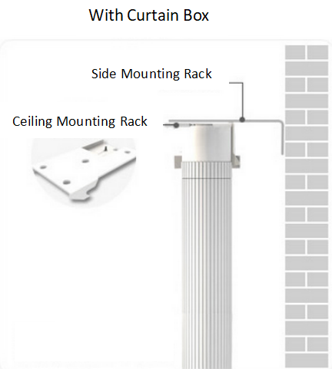
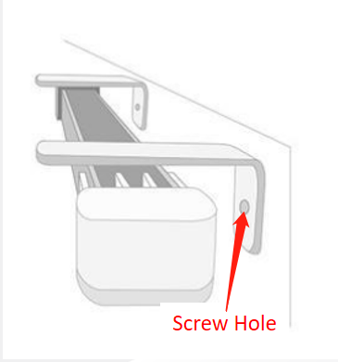
Product Installation
Side Mounting (No Curtain Box)
The side mounting surface shall be greater than 7cm (the requirements for monorail and double rail are the same).
Side Mounting (No Curtain Box)
*Can be installed only without curtain box

Slide 21
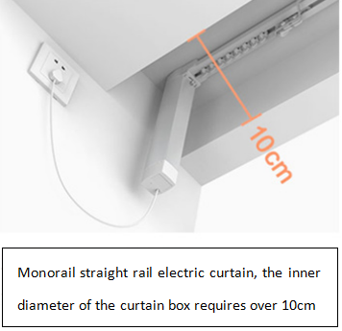
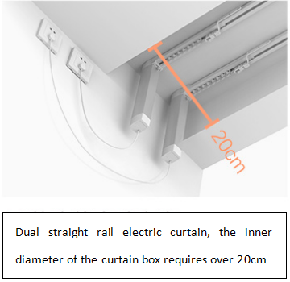
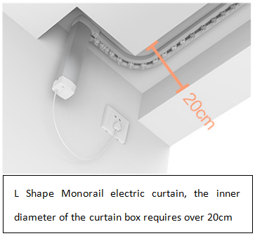
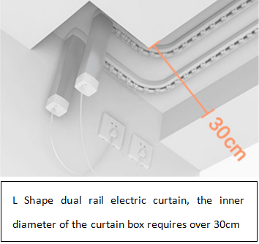
Product Installation
Reserved size of curtain slot
Straight Monorail 10CM Straight dual rail 20CM L Shape monorail 20CM L Shape dual rail 30CM

Slide 22
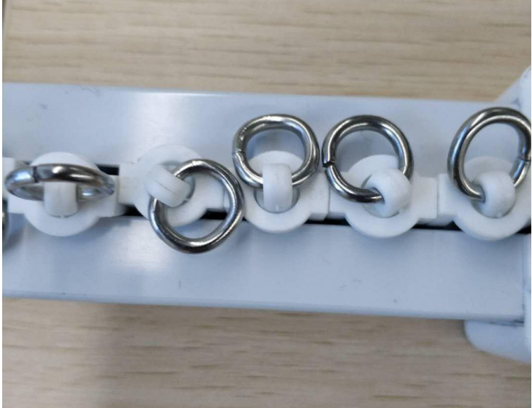
Product Installation
Curtain Requirement•
1. The curtain requires hooks due to the curtain track is hung by the circular hanging ring.
2. The weight of curtain shall not exceed 50KG.

Slide 23
Content
Product introduction
Product installation
Configuration on App
FAQ

Slide 24
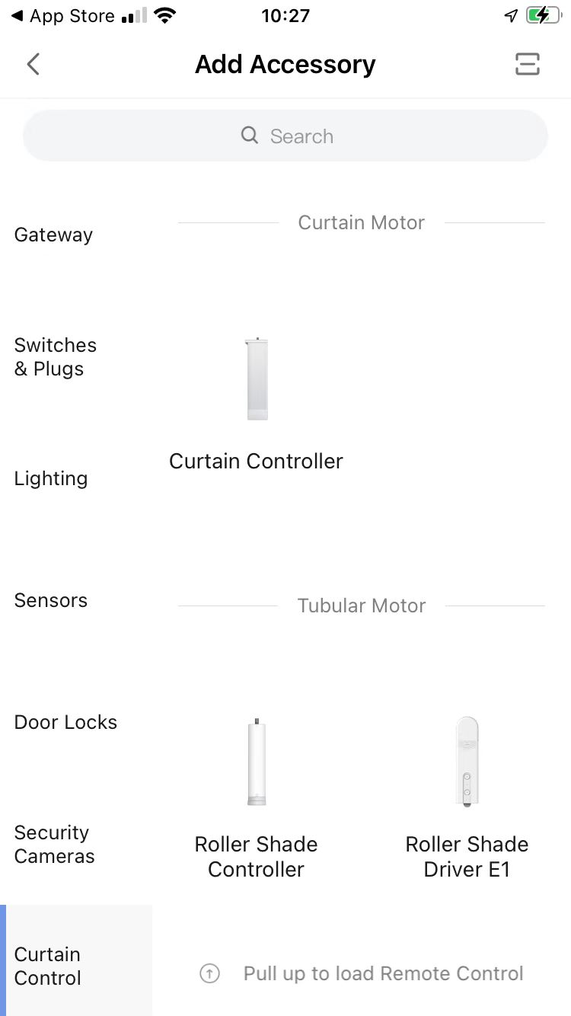
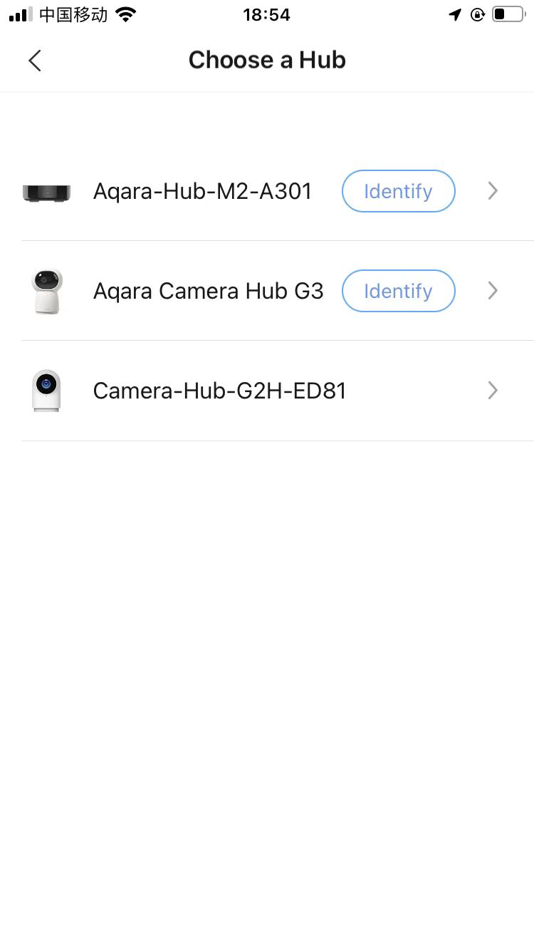
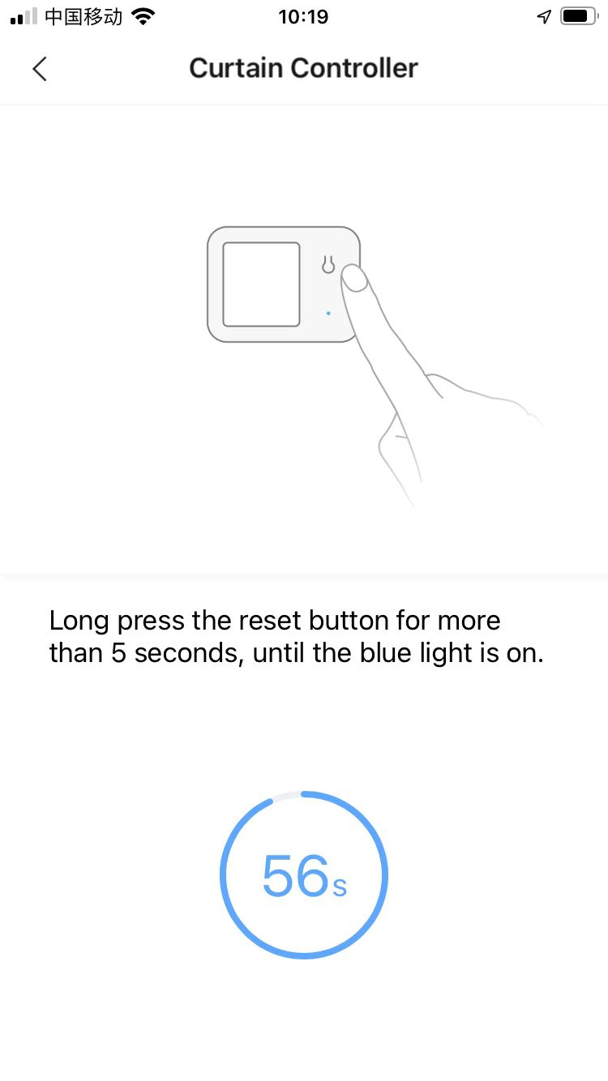
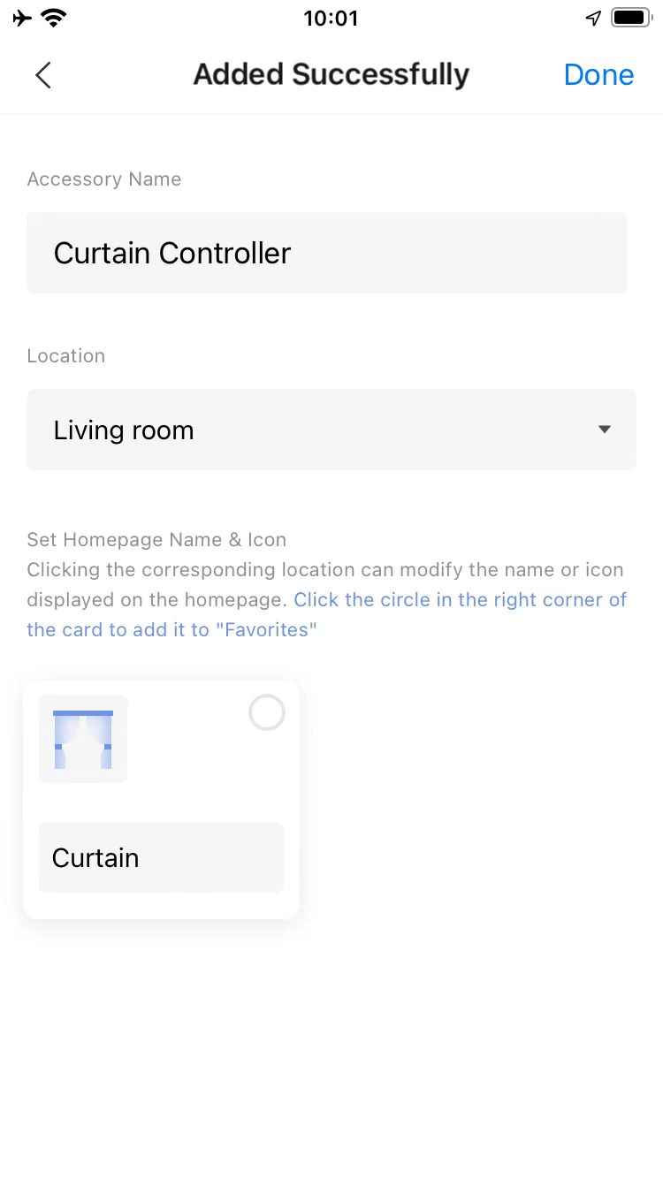
How to Bind Curtain Controller on App
Open the app, enter “Add Accessory” and select “Curtain controller” .
Choose a Hub. Please complete the hub binding before selecting a hub here.
Press and hold the reset button for more than 5s, until the blue light is on.
Click “Done” to complete the device binding.
1
6
4
5
3
2

Slide 25
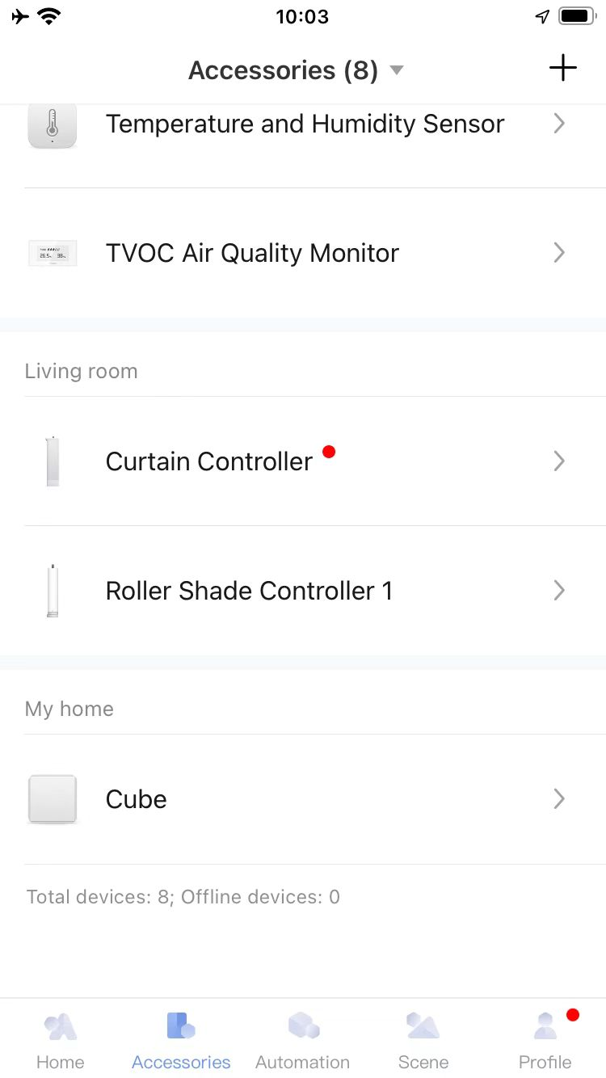
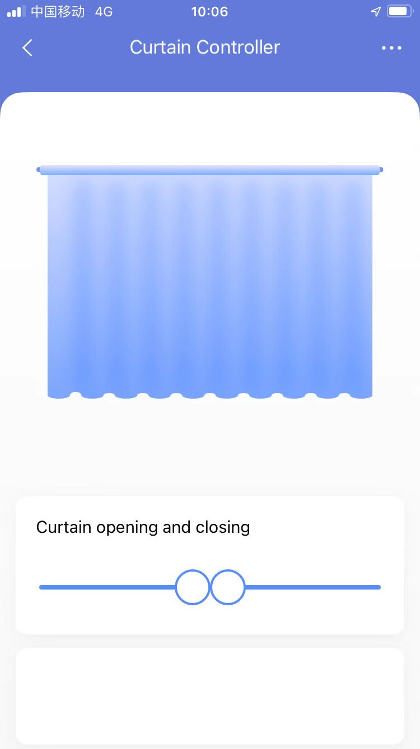
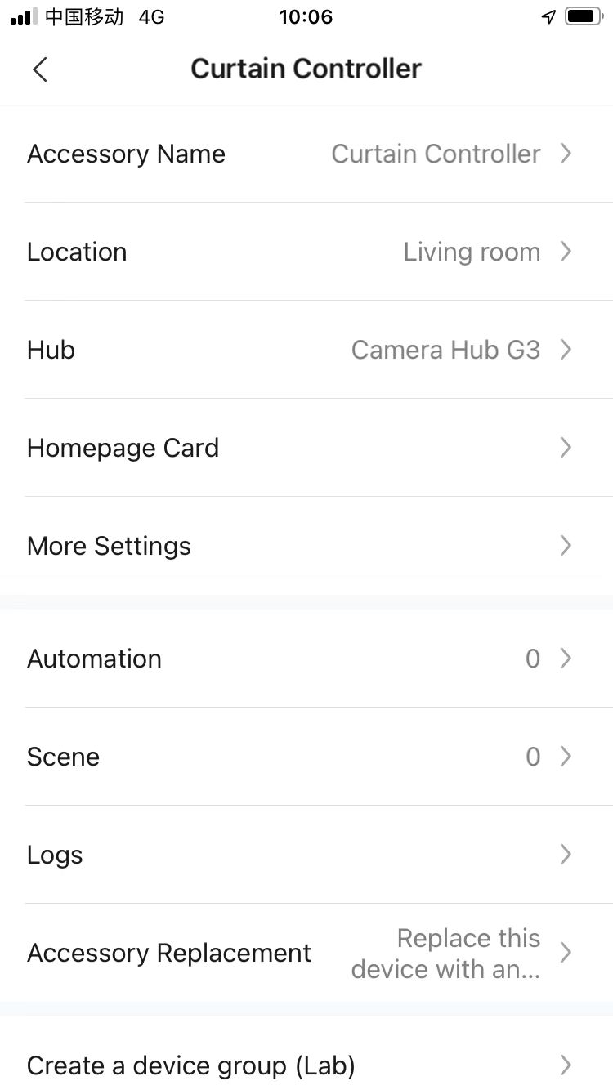
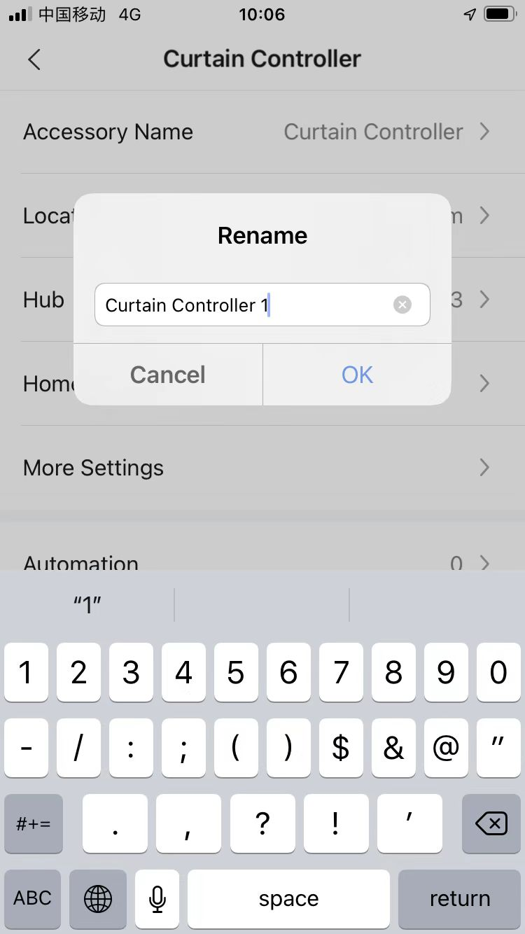
How to Rename the Device
Open the app, enter “Accessories” and select “Curtain controller” .
Click “...” .
Click “Accessory Name” .
Input new name and click “Confirm”.
3
4
2
5
1
*Once rename the device, the new name will display at the menu of “Accessories” on App.

Slide 26
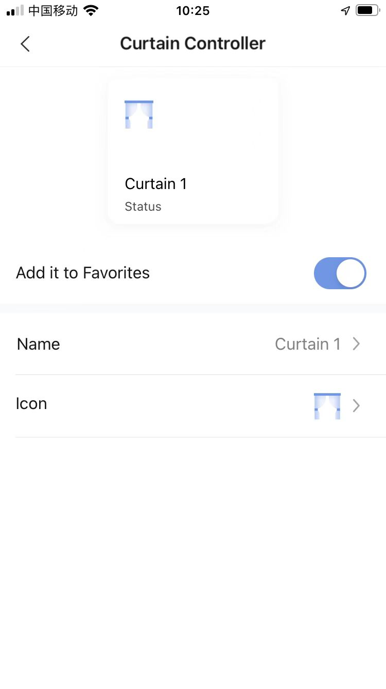
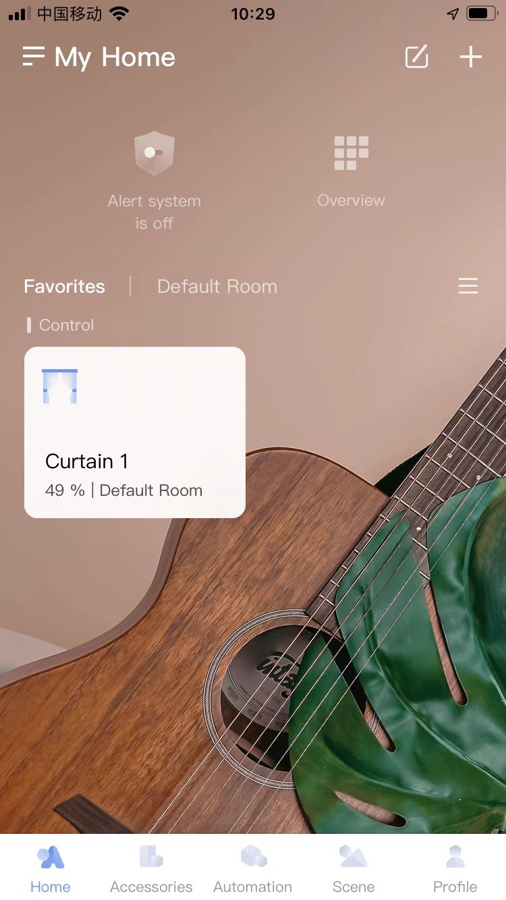
How to Add Device to “Favoriate” on Homepage
Open the app, enter “Curtain controller” . Then click ”Homepage Card”.
Enable “Add it to Favorites”.
Give the new name on the homepage for device as per requirement.
Go to the homepage and click “Favorites”. The device will display here.
5
1
2
6
3
4
*Once give the new name at step 3, the new name will display at “Favoriate”.

Slide 27
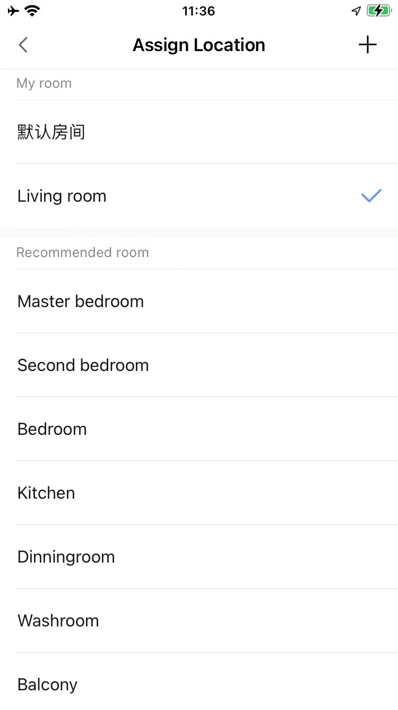
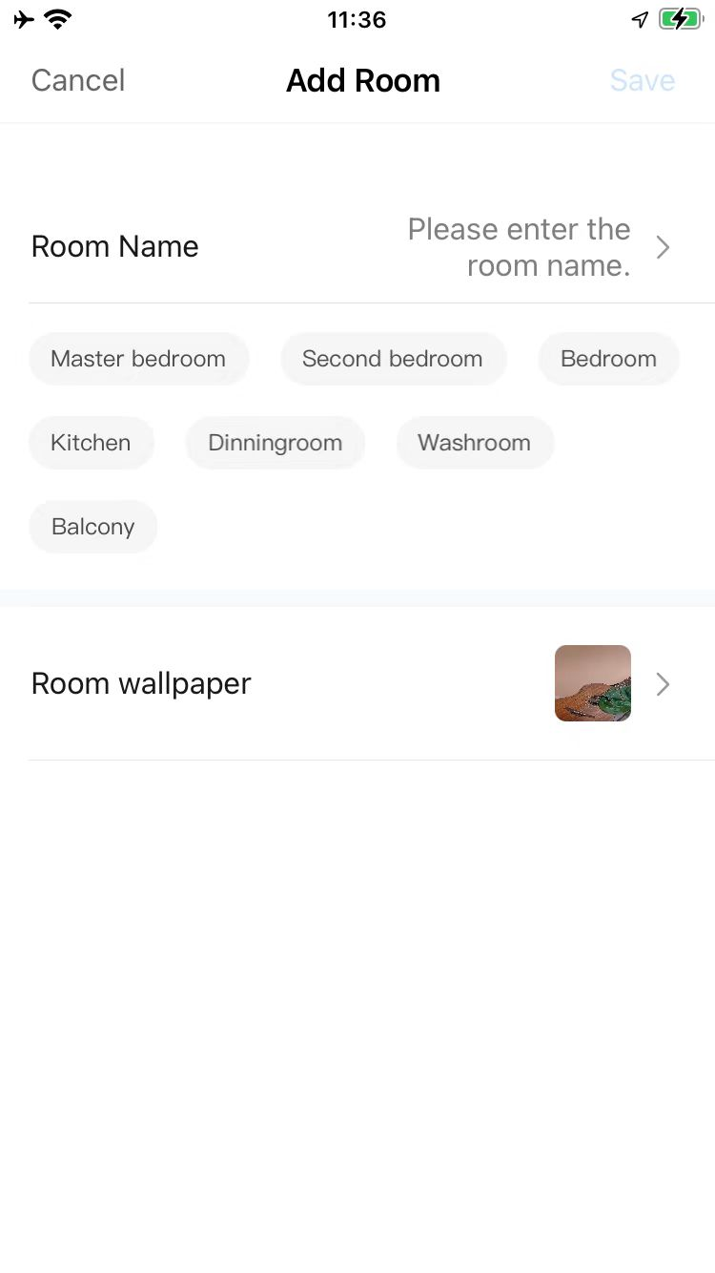
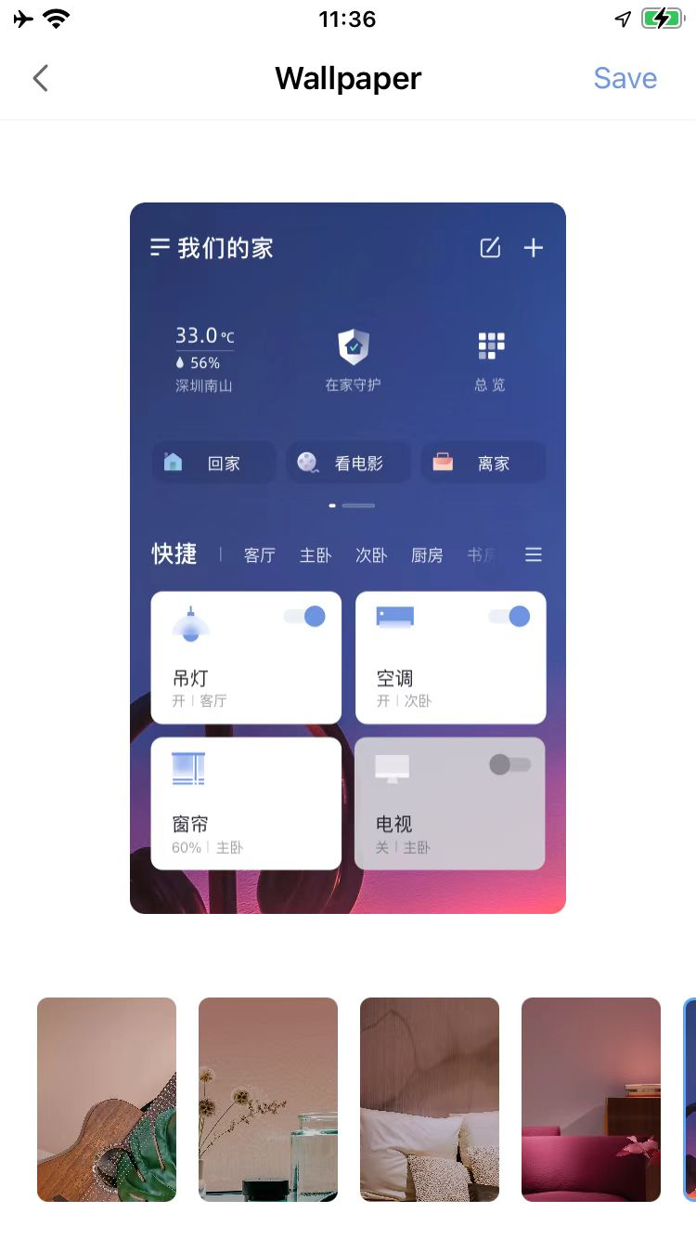
How to Set Location
Select the location: Step 1--Step 2;
Create new location: Step 1--Step 3--Step 4--Step 5, or you can select the name in the list here;
Select the wallpaper: Step 1--Step 3--Step 6--Step 7.
3
5
7
4
1
6
2

Slide 28
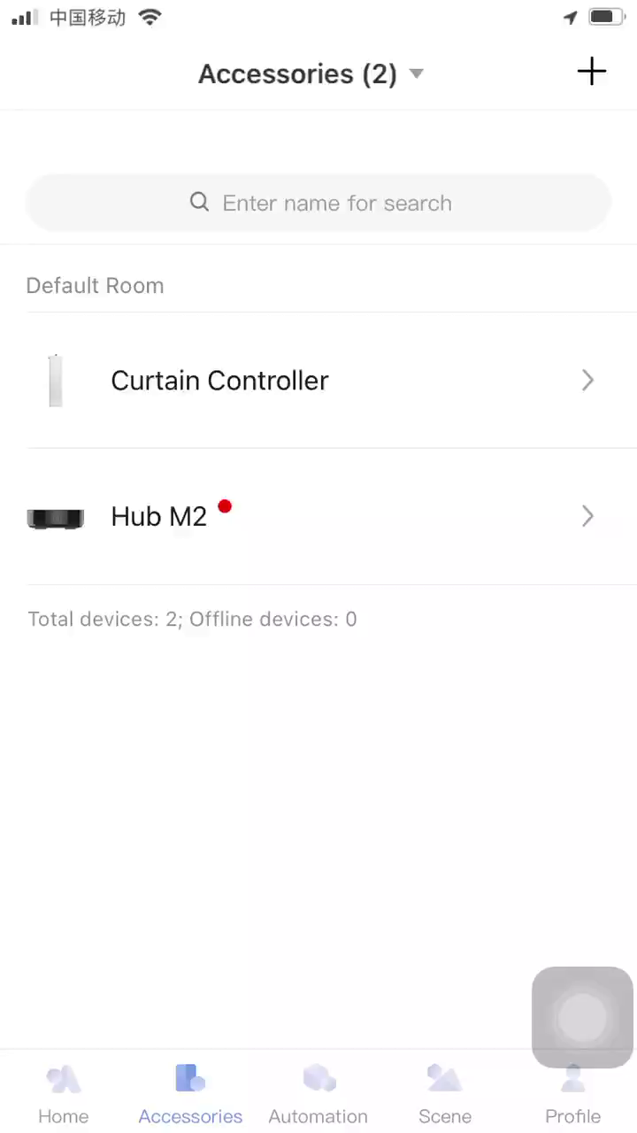
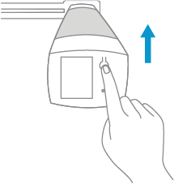
How to Identify the Device
Single press the reset button.
Check the device at the “Accessories” Page. The device will flash on App.
2
1

Slide 29
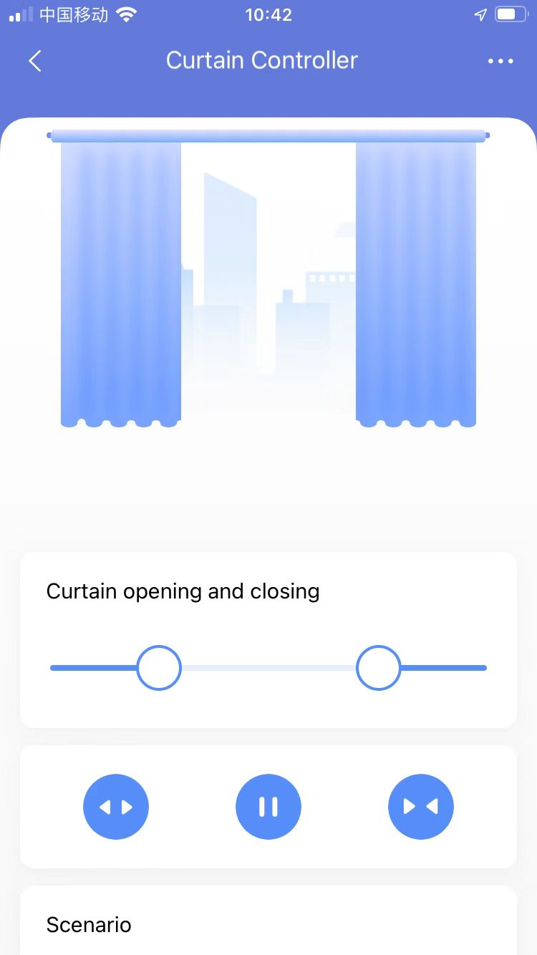
How to Control the Curtain on APP
Button to control the percentage of the opening/closing
Button to open/stop/close the curtain

Slide 30
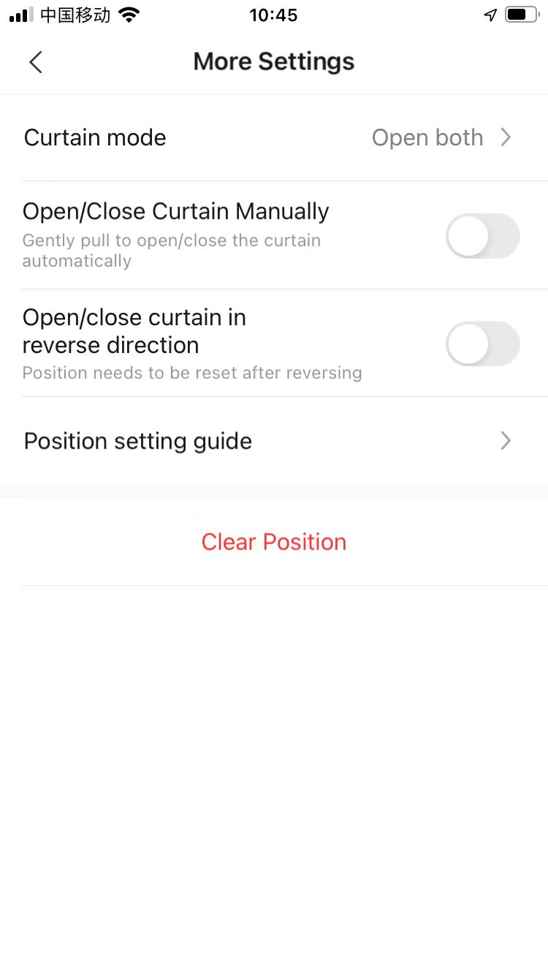
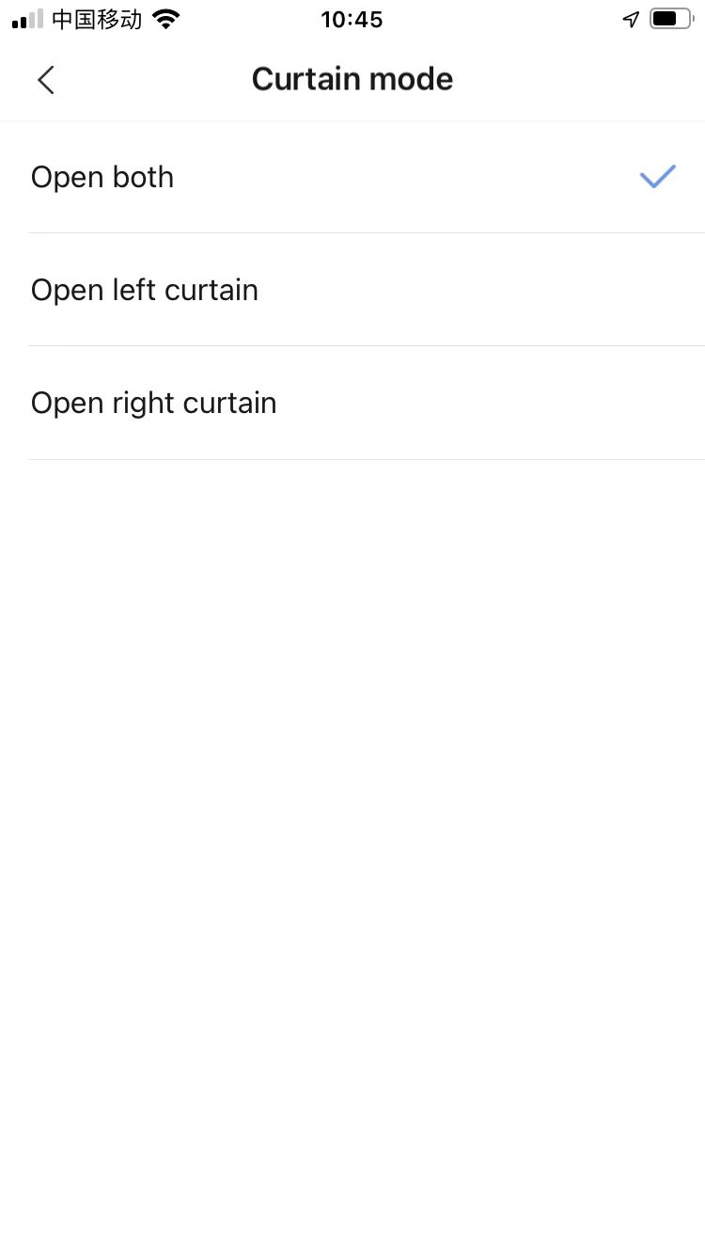
How to Select Curtain Mode
Click “More Settings”
Click “Curtain Mode”
Select the curtain mode from the list
2
1

Slide 31
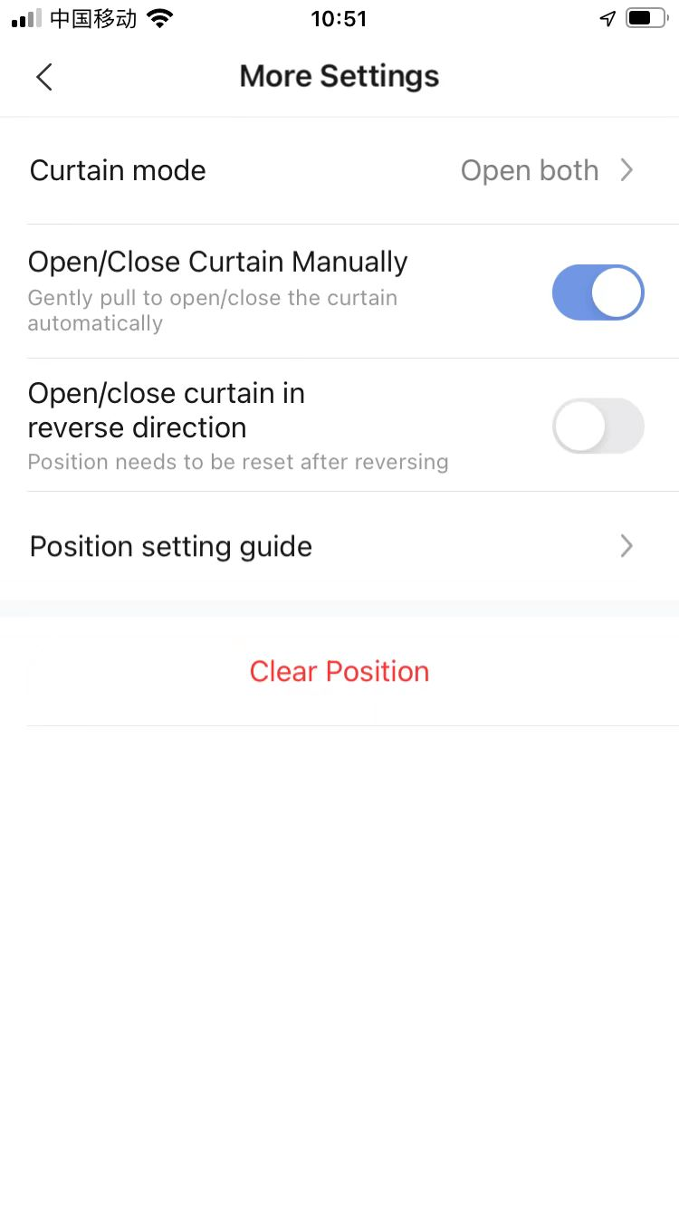
How to Set Open/Close Curtain Manually
Click “More Settings”
Enable “Open/Close Curain Manually”
2
1

Slide 32
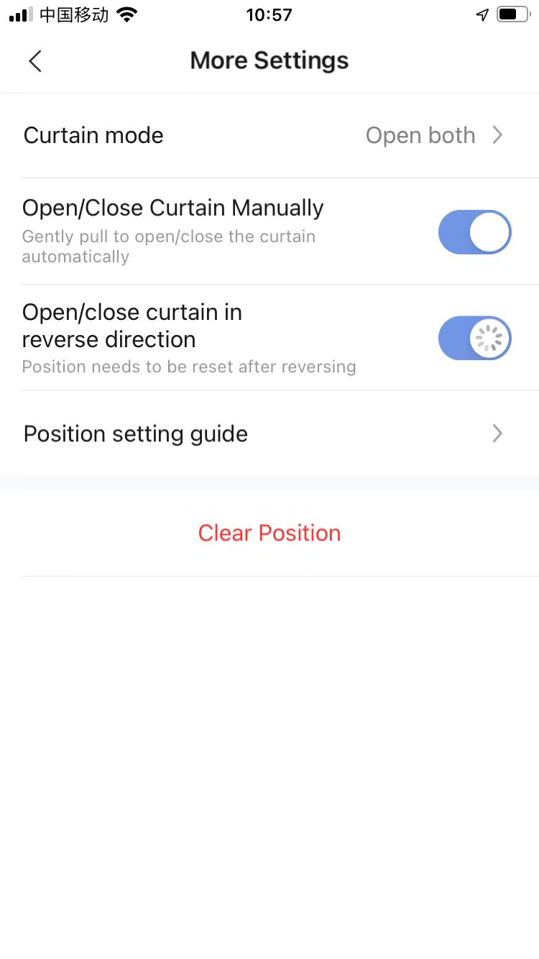
How to Set Open/Close Curtain in Reverse Direction
Click “More Settings”
Enable “Open/Close Curtain in Reverse Direction”
2
1

Slide 33
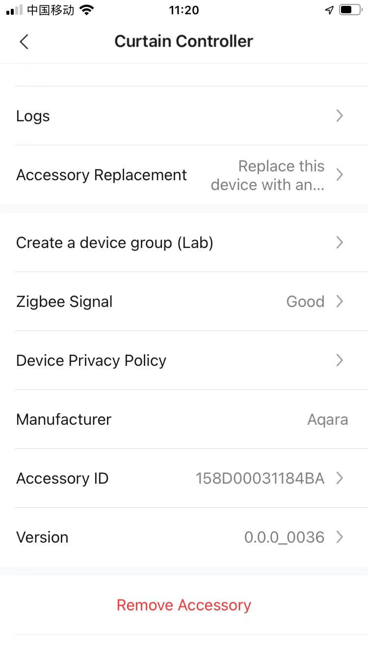
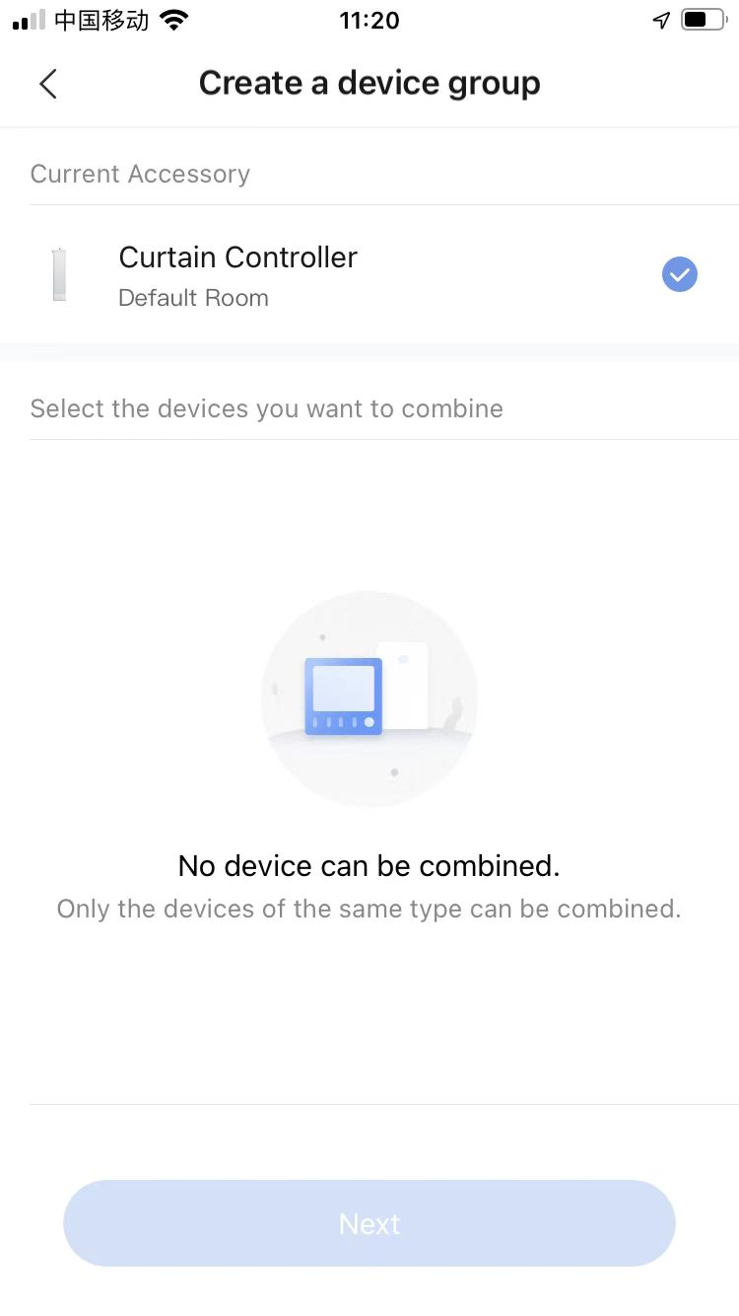
How to Create Device Group
Click “Create a device group”
Select the device and click “Next” to complete the setting.
2
1
3

Slide 34

How to Check Logs
Click “Logs” when enter “Curtain controller”.
Select the date.
2
1

Slide 35


How to Configure Automation and Scene
Aqara curtain controller supports the below Automation on Aqara Home App.
Please click “Automation” and “Scene” to start the configuration, below are the main steps on App.
IF:
Not support
Automation configuration
Scene configuration
Then:
Open
Close
Open/Close
Open to
Stop
Adjust curtain opening ratio (Only support cube rotation)
Set it to specified scene

Slide 36
Content
Product introduction
Product installation
Configuration on App
FAQ

Slide 37
FAQ for Curtain Controller
1. What is the maximum load the Aqara Curtain Controller supports?
50KG
2. How much is the torque of the Aqara Curtain Controller?
1.2N·m
3. When I pull the curtain manually, the curtain can not open or close automatically.
Please make sure that the "Open/close curtain manually" feature is enabled already in the app.
4. How to reset the Aqara Curtain Controller?
Please long-press the reset button for 5 seconds until the blue indicator light goes on and release it.
5. The curtain stopped halfway.
1. Please check if there are obstacles on the curtain track.
2. Clear the motor's route by the “Clear route” command in the app, and then try again.
6. Can the curtain be opened/closed after the Aqara Curtain Controller powers off?
Aqara Curtain Controller supports the " Manual" feature. The curtain can be opened/closed manually after the motor powers off.
7. If the curtain will close when we control the device to open it and vice versa, how could we adjust it to the correct direction?
Please adjust the direction through "Adjust opening/closing direction of curtain" in "Settings" in the app.

Slide 38
Thank you

